Slide 1

Employees Attrition Analysis
Presented by: Christopher Jerman II

Slide 2
Background of the problem
Employees leave their jobs daily and this action became a serious problem because it may lead to another problem such as the unemployment problem. Therefore, this short analysis focus on reasons that may lead employees to quit their jobs multiple times.

Slide 3
Dataset Sources
The dataset being used contains IBM employee attrition data for 2019 in the U.S. For reference, the original dataset is here.
The Colab Notebook is here.

Slide 4
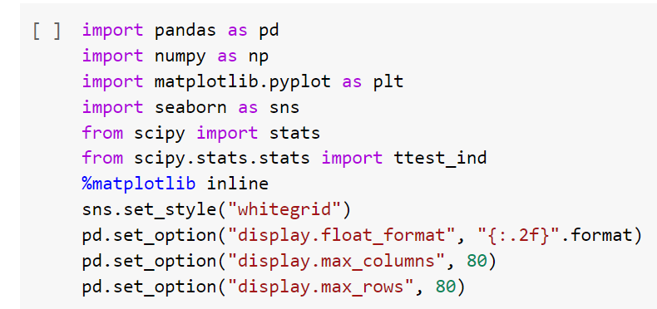
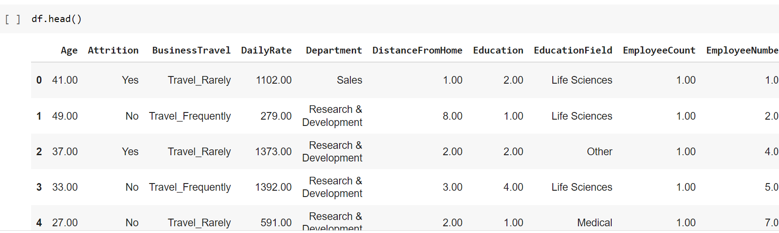
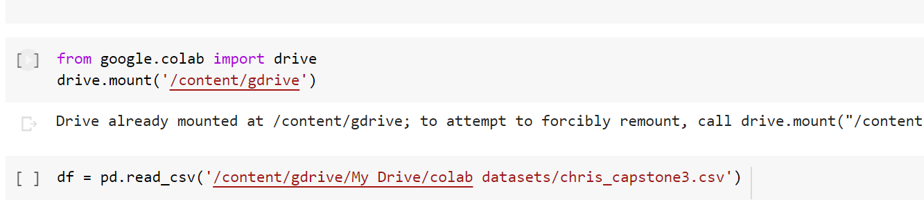
Dataset Exploring

Slide 5
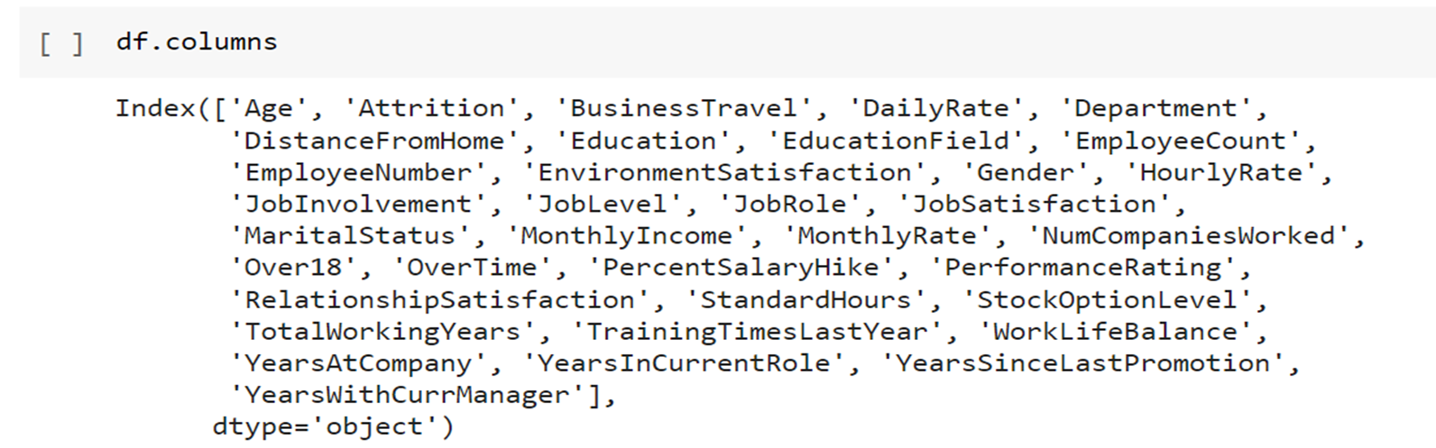
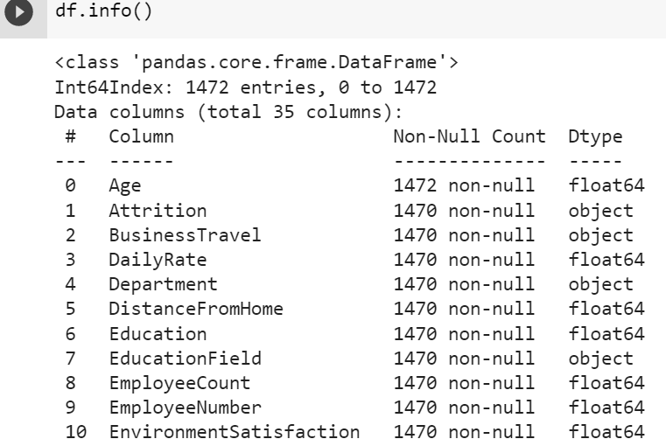
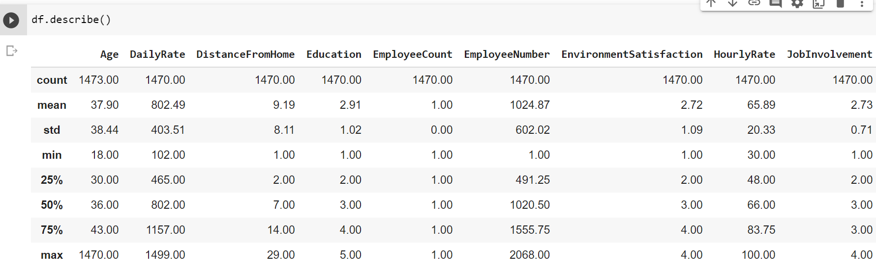
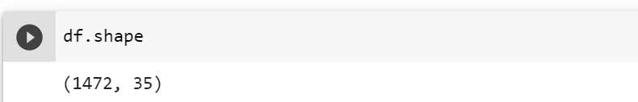
Dataset Source

Slide 6
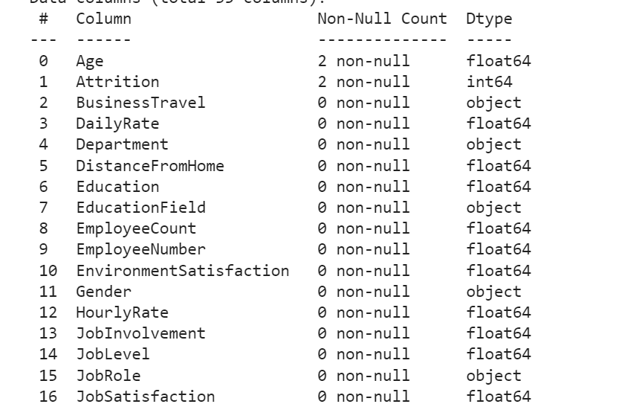
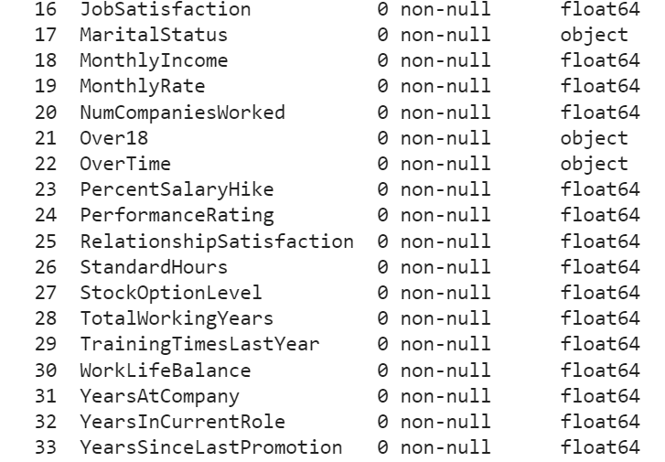
Dataset Fields

Slide 7
Data Analysis Strategies
The data will be used to test the hypotheses in the following way:
I will use visualizations to show a correlation between Monthly Income, Job level, and YearsAtCompany.
I’ll use t-tests to test the significant difference between the variables according to my sub-questions and hypotheses.

Slide 8

Research Questions & Hypotheses

Slide 9
Main Research Question
What factors are making employees stay at the company and not quit their job fast?

Slide 10
Sub questions &Hypotheses
Sub question1: Are the employees’ monthly income and Job level affecting employees’ decision on staying in the company?
Hypothesis #1: My first hypothesis: there is a correlation between total years at the company, job level, and monthly income.

Slide 11
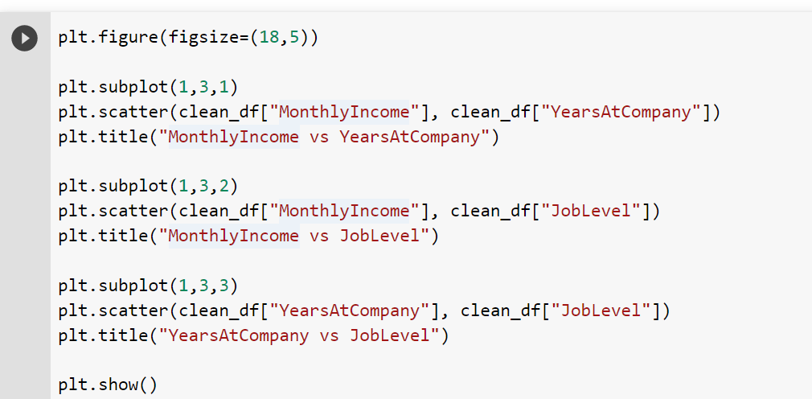
The Analyses – Hypothesis #1
For hypothesis #1, visualizations were used to show correlations between employee monthly income, job level, and years at the company.

Slide 12
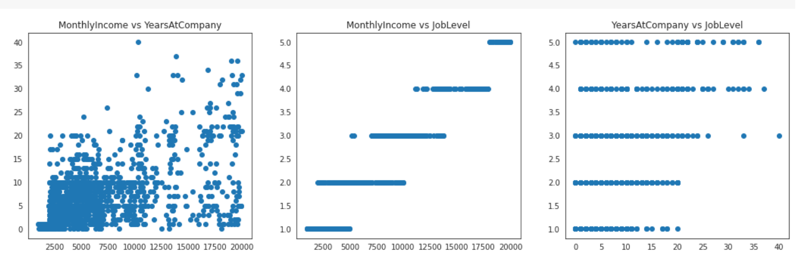
Continue… analyses – hypothesis #1
The visualizations show strong correlations between each of the three variables above.

Slide 13
Sub questions &Hypotheses
Sub#2: Is there any impact of job role on employees staying at the same company long time?
Hypothesis#2: Different job roles don’t significantly affect employees’ staying at the company.

Slide 14
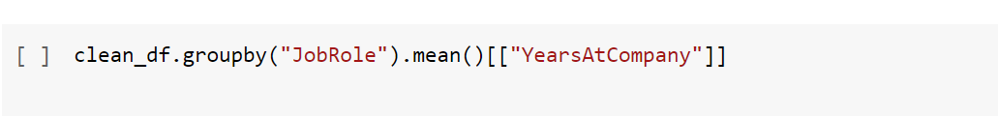
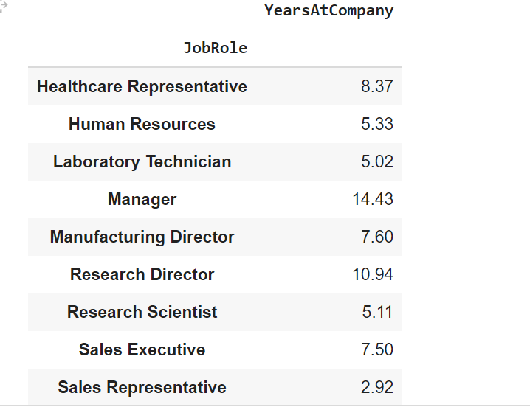
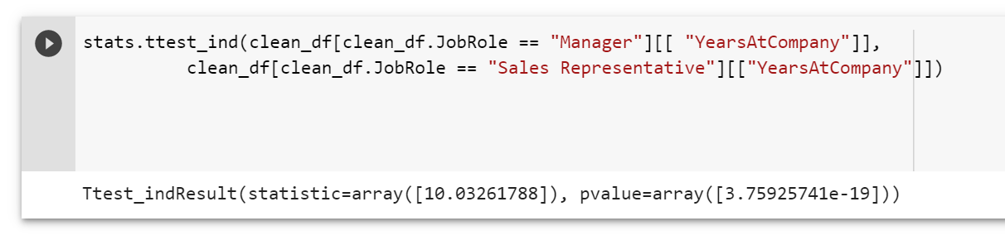
The analyses – hypothesis # 2
Summary of findings for hypothesis #2 The Hypothesis is rejected. The t-test shows that there is a significant difference in the mean(10.14024898) between YearsAtCompany for different Job Role types. In addition, the p-value is extremely small(3.75925741e-19) This means that employees in management roles (high job level) stay at the company more than those who are in entry-level job roles (Low JobLevel) such as Sales Representative.

Slide 15
Conclusion
Employees with low Job Levels, Monthly Income, low YearAtCompany, low education, and low TotalWorkingYears are more likely to quit their jobs.

Slide 16

Recommendation
Human Resource and Organizational leaders need to have a clear plan to keep their employees from quitting their job. Monthly income is an important factor in making employees stay at the company. Therefore, there needs to provide employees with good pay and enroll them in various training to level up their skills, job roles, and job level.
A successful company has successful employees, therefore is critical for organizational leaders to take care of their staff from two sides financial side (raise their pay) and the educational side (enrolling employees in job training) to raise employees' commitment to the company.

Slide 17

Thank you!
Questions?

